Slide 1
Seismic Insights
Exploring Earthquake Data Patterns and Anomalies

Slide 2
Deep Dive into EARTHQUAKE Analysis
The first part will examine earthquake types, their magnitudes, and how they relate to depth.
The second part will investigate errors, their potential causes, and the associated patterns.

Slide 3
Part I earthquake types, magnitudes and depths

Slide 4
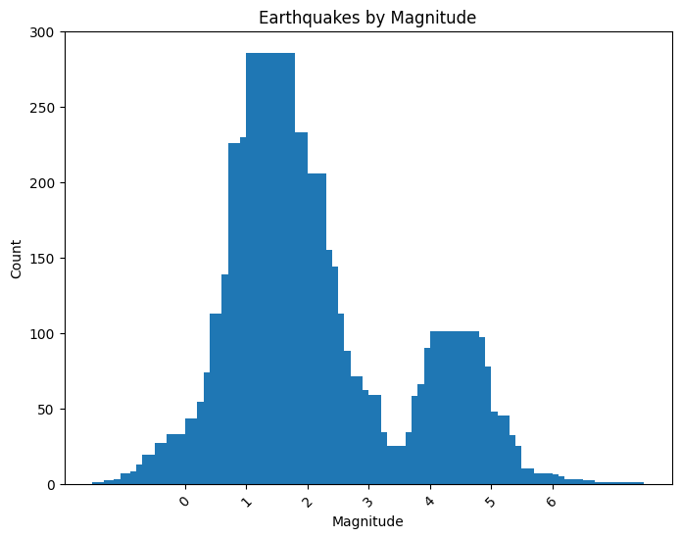
Earthquakes by magnitude
The attached visualization clearly shows that most earthquakes have a magnitude between 0 and 3, followed by a smaller number of earthquakes with a magnitude between 4 and 5.

Slide 5
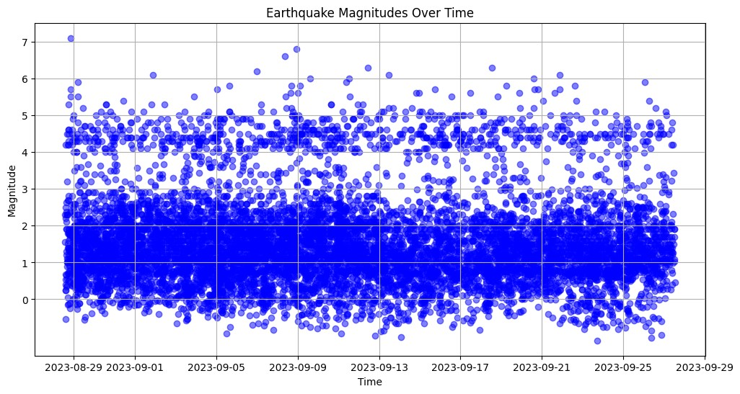
This chart displays earthquake magnitudes over time. It reveals a consistent pattern of earthquakes with magnitudes between 0 and 3, and a less frequent occurrence between 3 and 4, as evidenced by the visible gap in white

Slide 6
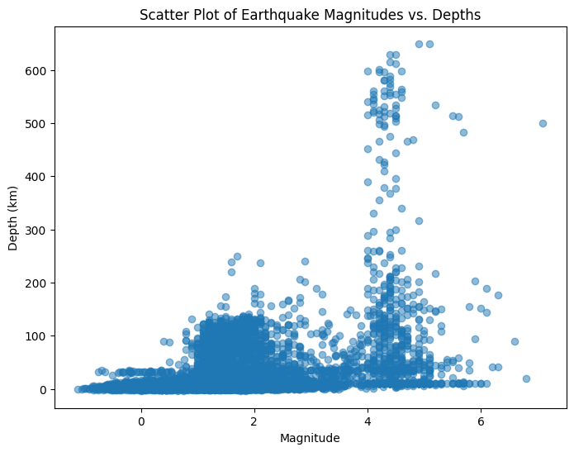
Earthquake Mag VS Depths
There appears to be clear evidence that greater depth is associated with a higher likelihood of earthquakes with higher magnitudes.

Slide 7
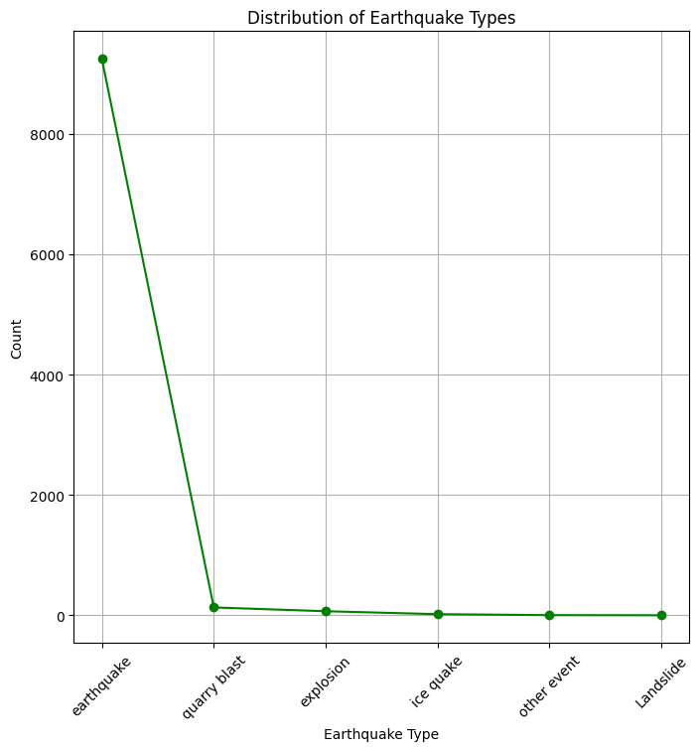
Here, we can observe the distribution of earthquake types. The standard earthquake type predominates, while the other types collectively represent a smaller proportion of the total.

Slide 8
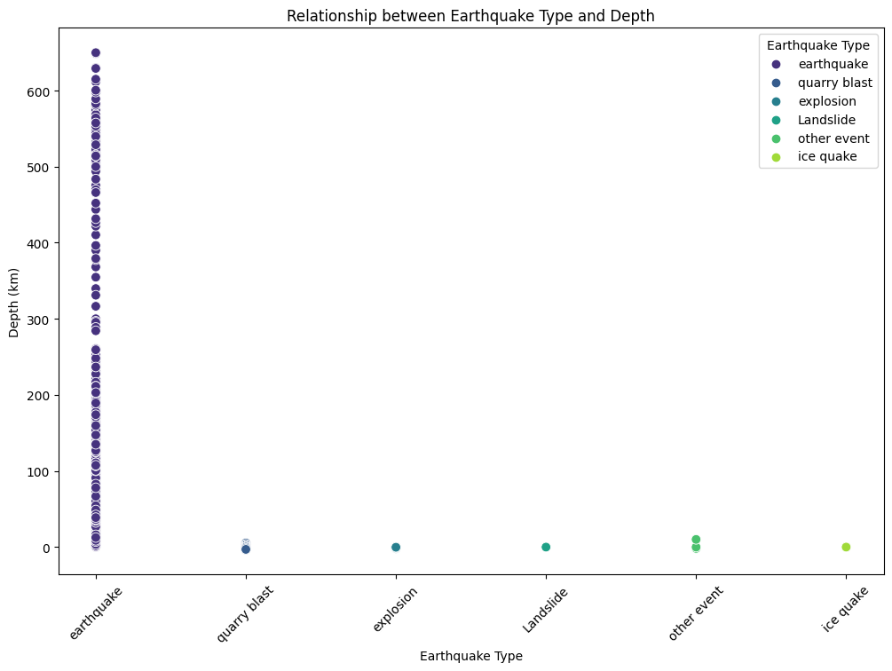
In this representation, it's evident that standard earthquakes can occur at various depths, whereas the other types are primarily surface earthquakes or occur at shallow depths.

Slide 9
Part II erorRs and correlations

Slide 10
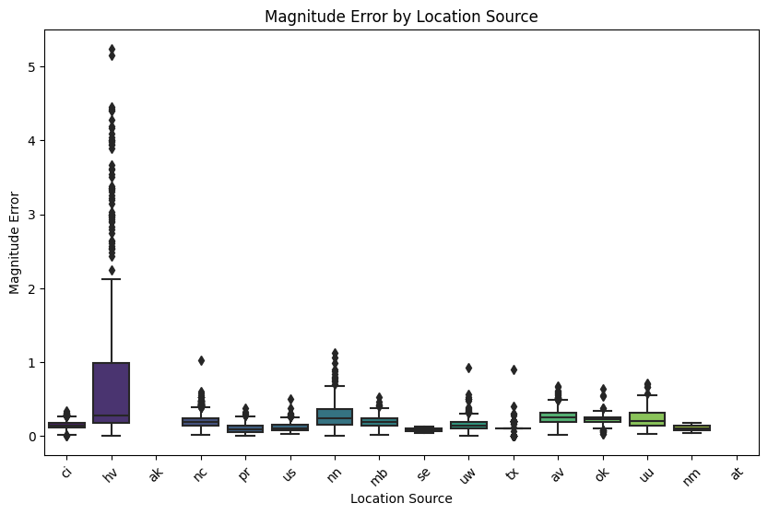
In this representation, it's clear that the majority of magnitude errors originate from the "hv" location. Within the "hv" location, most errors fall within the range of 0 to 1, with the most frequent error being around 0.2. Magnitude errors generally range from 0 to 2.2, but there are also unusual errors exceeding 2.2, some even exceeding 5.

Slide 11
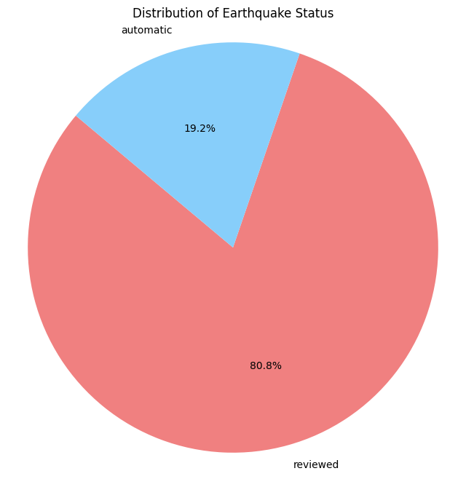
The pie chart illustrates the distribution of earthquake statuses. "Automatic" status indicates detection by seismographic systems, while "Reviewed" status suggests that the earthquake may undergo comprehensive analysis by seismologists.
The subsequent chart aims to uncover a correlation between magnitude errors and the earthquake's status.

Slide 12
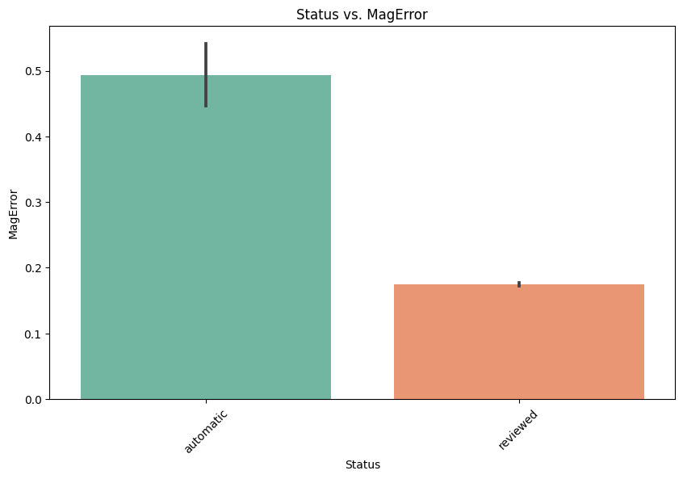
This visualization indicates that earthquakes with a "Reviewed" status, which undergo thorough analysis by seismologists, tend to exhibit lower magnitude errors compared to those with an "Automatic" status.

Slide 13
conclusions
Earthquakes with magnitudes between 0 and 3 are most common, followed by a smaller number with magnitudes between 4 and 5.
Greater depth is associated with a higher likelihood of earthquakes with higher magnitudes.
Standard earthquakes occur at various depths, while other types are mainly surface or shallow.
Most magnitude errors come from the "hv" location, with errors typically ranging from 0 to 2.2 and some unusual errors exceeding 2.2.
"Reviewed" status earthquakes, subject to analysis by seismologists, tend to have lower magnitude errors compared to "Automatic" status earthquakes.

